Slide 1
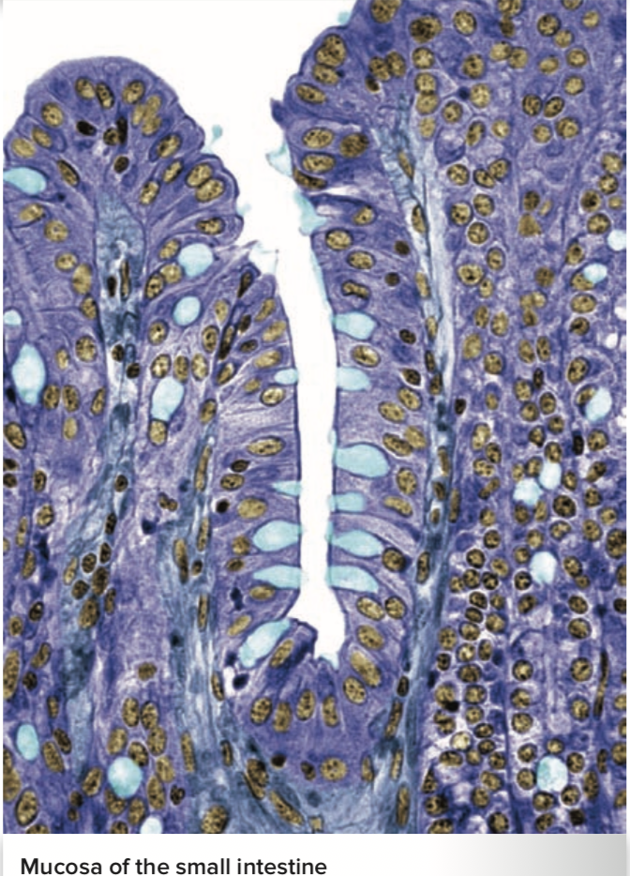
The Digestive System
Al-Farabi Kazakh National University
Higher School of Medicine
General Anatomy and Digestive Processes. The Mouth Through Esophagus
Figure from: Saladin, Anatomy & Physiology, McGraw Hill, 2018

Slide 2
LEARNING OUTCOMES
As a result of the lesson you will be able to:
List the functions and major physiological processes of the digestive system;
Distinguish between mechanical and chemical digestion;
Identify the basic chemical process that underlies all chemical digestion, name the major substrates and products of this process;
List the regions of the digestive tract and the accessory organs of the digestive system;
identify the layers of the digestive tract and describe its relationship to the peritoneum;
describe the general nervous and chemical controls over digestive function
describe the gross anatomy of the digestive tract from the mouth through the esophagus;
describe the composition and functions of saliva; and
describe the nervous control of salivation and swallowing.
Al-Farabi Kazakh National University
Higher School of Medicine

Slide 3
Before we go on
most nutrients we eat cannot be used in their existing form
must be broken down into smaller components before our body can make use of them
Hydrolysis reactions
monomers and polymers
pH on enzyme action
Al-Farabi Kazakh National University
Higher School of Medicine

Slide 4
Medical terms
Gastroenterology [gastro stomach; entero = intestines; logy = study of ] – the study of the digestive tract and the diagnosis and treatment of its disorders
Alimentary [aliment = food]
Enteric[enter = intestine] nervous system -which regulates digestive tract motility, secretion, and blood flow.
fauces[fauces = throat ]
parotid[par=next to;ot=ear ] glands
Al-Farabi Kazakh National University
Higher School of Medicine

Slide 5
The Digestive System
Digestive system – the organ system that processes food, extracts nutrients from it, and eliminates the residue
Why we call the digestive system a “disassembly line”?
Al-Farabi Kazakh National University
Higher School of Medicine

Slide 6
Digestive Function
five stages of digestion
ingestion
digestion
absorption
compaction
defecation
mechanical digestion – the physical breakdown of food into smaller particles
chemical digestion – a series of hydrolysis reactions that breaks dietary macromolecules into their monomers (residues)
Al-Farabi Kazakh National University
Higher School of Medicine

Slide 7
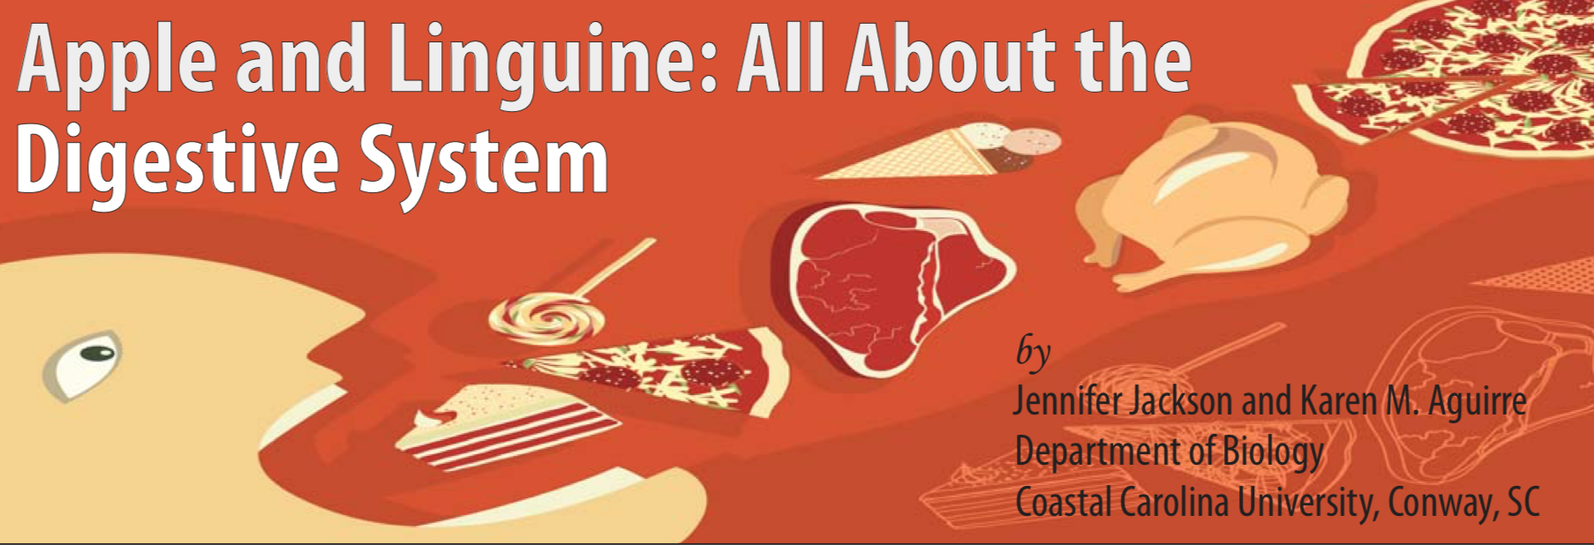
Al-Farabi Kazakh National University
Higher School of Medicine

Slide 8
Background Information
The organs of the digestive system are the mouth, esophagus, liver, gall bladder, pancreas, stomach, small intestine, large intestine and the anus, which all together make up the gastrointestinal (GI) tract. The system is responsible for turning food into usable nutrients that can be mobilized to different parts of the body. Each organ and its associated enzymes play a specific role in this process, breaking down complex foods into their individual building block components (e.g., proteins are digested into amino acids). A well balanced diet, coupled with a functional, healthy GI tract, lead to a well-nourished and healthy individual.
Al-Farabi Kazakh National University
Higher School of Medicine

Slide 9
Video Review
Questions
1. True or False: People should eat a balanced diet, so each person should eat approximately equal amounts of food from each of the major food groups (fruits, grains, proteins, vegetables) daily. Explain your answer.
2. About how long does it take to completely digest a generic dinner—say, a chicken breast plus a baked potato and salad and a cup of sherbet, from eating to complete elimination in the stool?
a. One hour b. Two hours c. Four hours
d. Transit through the colon is highly variable but it can take as long as 50 hours to elimination.
3. Where does the vast majority of absorption of nutrients from food take place?
Al-Farabi Kazakh National University
Higher School of Medicine

Slide 10
Video Review
Questions
1. In a few brief sentences, explain the purpose of the “Choose My Plate” graphic that appears in the video.
2. According to the video, which food groups should you have a lot of? The least of?
3. Provide a brief paragraph using your prior knowledge and the information from the video explaining why you should have more of one food group versus another.
Al-Farabi Kazakh National University
Higher School of Medicine

Slide 11
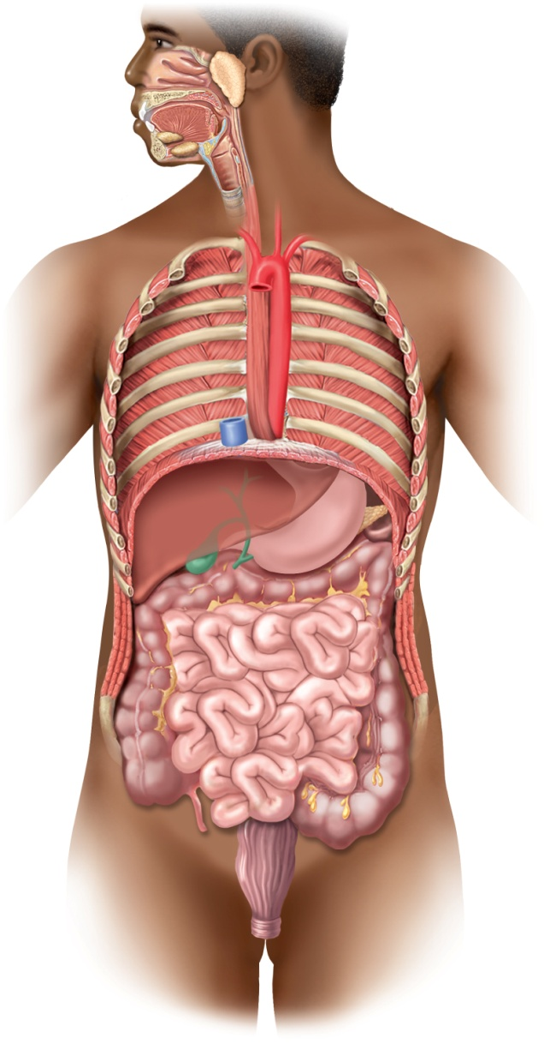
General Anatomy
Copyright © The McGraw-Hill Companies, Inc. Permission required for reproduction or display. Figure from: Saladin, Anatomy & Physiology, McGraw Hill, 2018
Digestive system has two anatomical subdivisions
digestive tract (alimentary canal)
mouth, pharynx, esophagus, stomach, small intestine, and large intestine
accessory organs
teeth, tongue, salivary glands, liver, gallbladder, and pancreas
Oral cavity
Tongue
Parotid
gland
Teeth
Sublingual gland
Pharynx
Submandibular
gland
Esophagus
Diaphragm
Liver
Stomach
Pancreas
Gallbladder
Transverse
colon
Bile duct
Ascending
colon
Descending
colon
Small intestine
Cecum
Appendix
Sigmoid
colon
Rectum
Anal canal
Anus
Al-Farabi Kazakh National University
Higher School of Medicine
Figure 25.1

Slide 12
Variations in Layers of GI Tract
mucosa
submucosa
muscularis externa
serosa
What is GI Tract?
Al-Farabi Kazakh National University
Higher School of Medicine

Slide 13
Enteric Nervous System
enteric nervous system – a nervous network in the esophagus, stomach, and intestines that regulated digestive tract motility, secretion, and blood flow
composed of two networks of neurons
submucosal (Meissner) plexus – in submucosa
controls glandular secretion of mucosa
controls movements of muscularis mucosae
myenteric (Auerbach) plexus – parasympathetic ganglia and nerve fibers between the two layers of the muscularis interna
controls peristalsis and other contractions of muscularis externa
Al-Farabi Kazakh National University
Higher School of Medicine

Slide 14
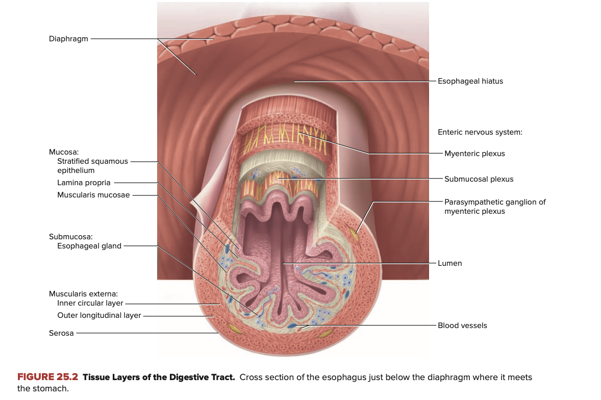
Copyright © The McGraw-Hill Companies, Inc. Permission required for reproduction or display.
Figure from: Saladin, Anatomy & Physiology, McGraw Hill, 2018
Al-Farabi Kazakh National University
Higher School of Medicine

Slide 15
Relationship to Peritoneum
mesenteries – connective tissue sheets that loosely suspend the stomach and intestines from the abdominal wall
What is the function of mesenteries?
Al-Farabi Kazakh National University
Higher School of Medicine

Slide 16
Relationship to Peritoneum
parietal peritoneum – a serous membrane that lines the wall of the abdominal cavity
What is the function of parietal peritoneum?
Al-Farabi Kazakh National University
Higher School of Medicine

Slide 17
Relationship to Peritoneum
lesser omentum – a ventral mesentery that extends from the lesser curvature of the stomach to the liver
greater omentum – hangs from the greater curvature of the stomach
What is the function of lesser and greater omentum?
Al-Farabi Kazakh National University
Higher School of Medicine

Slide 18
Relationship to Peritoneum
mesocolon – extension of the mesentery that anchors the colon to the posterior abdominal wall
intraperitoneal – when an organ is enclosed by mesentery on both sides
retroperitoneal – when an organ lies against the posterior body wall and is covered by peritoneum on its anterior side only
Al-Farabi Kazakh National University
Higher School of Medicine

Slide 19
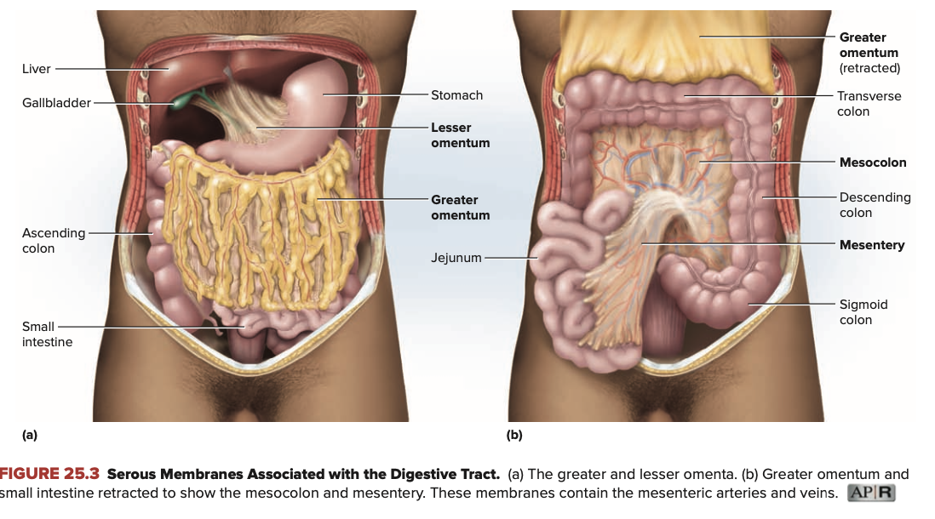
Copyright © The McGraw-Hill Companies, Inc. Permission required for reproduction or display.
Figure from: Saladin, Anatomy & Physiology, McGraw Hill, 2018
Al-Farabi Kazakh National University
Higher School of Medicine

Slide 20
Regulation of Digestive Tract
motility and secretion of the digestive tract are controlled by neural, hormonal, and paracrine mechanisms
neural control
short (myenteric) reflexes and long (vagovagal) reflexes
hormones
chemical messengers ,gastrin and secretin
paracrine secretions
chemical messengers that diffuse through the tissue fluids to stimulate nearby target cells
Al-Farabi Kazakh National University
Higher School of Medicine

Slide 21
Video Review
A gastric bypass procedure, like any major surgery, disrupts and can even threaten the life of the patient. Yet gastric bypass is often considered by individuals when quality of life is significantly reduced by obesity. What factors might persuade a doctor to recommend such a procedure?
a) When the patient is morbidly obese.
b) When multiple episodes of dieting have failed.
c) When multiple exercise regimes have failed.
d) When obesity is a threat to the physical and/or mental health of the individual.
e) When the patient is healthy enough to undergo this major surgery.
f) All of the above must be present.
Al-Farabi Kazakh National University
Higher School of Medicine

Slide 22
Video Review
What are the actual physical modifications to the gastrointestinal tract when the Roux-en-Y gastric bypass procedure is performed?
a) The capacity of the stomach is surgically decreased to about one cup volume.
b) A portion of the upper small intestine is disconnected from the GI tract.
c) The Roux gland is disconnected from the GI tract.
d) The ileum is removed.
e) All of the above are true.
f) (a) and (b) only are correct.
Al-Farabi Kazakh National University
Higher School of Medicine

Slide 23
Video Review
Why does the procedure result in weight loss?
a) The patient “feels full” much more quickly—it is actually uncomfortable to eat too much.
b) Some of the absorptive area of the small intestine is bypassed, so fewer calories are absorbed.
c) The reconnection of ducts from the pancreas and the bile duct allows for secretion of some digestive enzymes that are necessary for complete breakdown of food.
d) The procedure decreases the peristaltic capability of the lower intestine.
e) All of the above are true.
f) (a) and (b) only result in weight loss.
Al-Farabi Kazakh National University
Higher School of Medicine

Slide 24
Mini-Case #1 – Lillian’s Story
Lillian was 21 years old and morbidly obese. As a very young teenager, she had problems with binge eating. Now, she had settled into a pattern of eating when she was lonely, eating when she got a bad grade, and even eating when she felt bad about her weight. Lillian had talked about marrying Mark since kindergarten, when they got engaged on the playground. Now, he bought her a beautiful ring and the couple was planning a summer wedding. Lillian wanted to look pretty in her bride’s dress. She wanted the energy and grace to dance all night at her reception. More importantly, she wanted to be able to walk and run and fulfill her dreams of teaching active young elementary school children. She wanted to be slim enough to carry a baby with minimum risk, and start her own family. She weighed 312 pounds when her doctor began talking to her about gastric bypass surgery (also called bariatric surgery). Before the procedure, Lillian gave a complete dietary history to a specially trained nurse and underwent a battery of tests to show that she could physically withstand the procedure. She also saw a counsellor who explored Lilian’s rationale and expectations from the surgery.
The procedure he recommended is diagrammed in Figure 1.

Slide 25
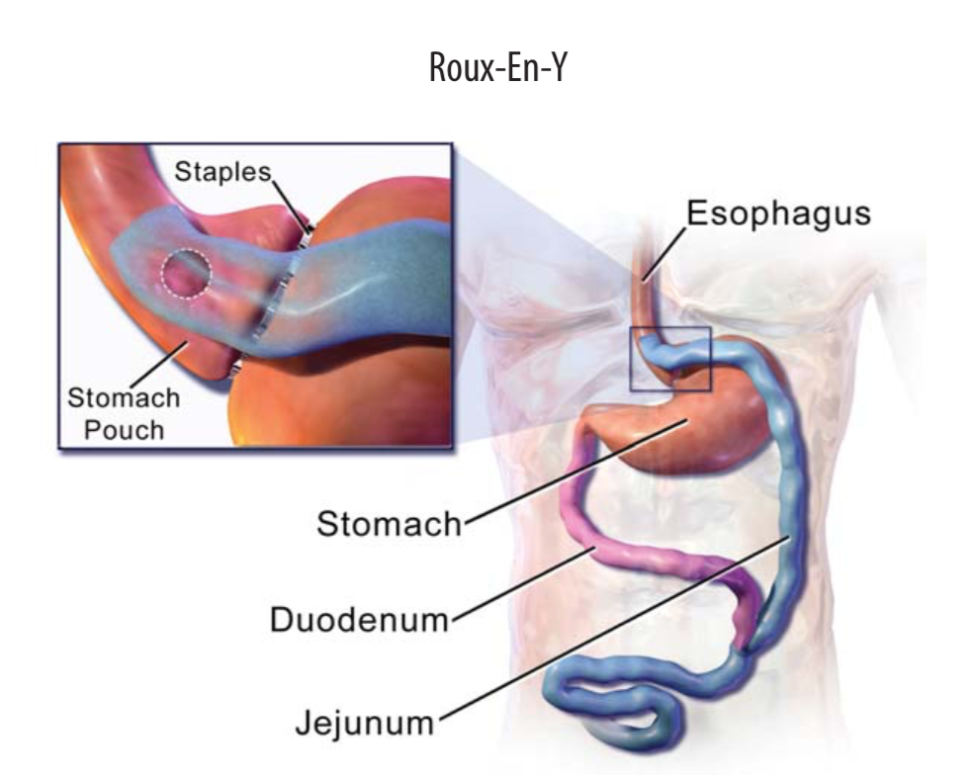
Gastric By-Pass Surgery. Note that a very small piece of the stomach remains connected to the esophagus after surgery—the majority of the stomach is cut away. Moreover, the duodenum is left connected to that large, now disconnected part of the stomach, and the jejunum, the primary site of nutrient uptake from food, is newly connected to the small, still functional, stomach pouch.

Slide 26
Questions
1. How does limited stomach volume affect weight loss?
The gall bladder secretes bile, which emulsifies fats, and the pancreas secretes digestive enzymes, both into the duodenum. Moreover, the duodenum is the primary site of dietary iron uptake. How might the reconnection of the duodenum aid in digestion?
Al-Farabi Kazakh National University
Higher School of Medicine

Slide 27
Video Review
Many different types of micro-organisms can disrupt the function of the gastrointestinal tract. V. cholera is a good example, causing short acute bouts of dizziness, disorientation, and diahrrea that, if untreated, can even be fatal. The cholera organism itself is a(n) …
a) bacterium. b) fungus.
c) virus.
d) parasite.
e) worm.
f) tick.
Al-Farabi Kazakh National University
Higher School of Medicine

Slide 28
Video Review
How does V. cholera most frequently gain entry to the body?
a) The bite of a mosquito or sand fly.
b) Living in a household with another person who has cholera.
c) Drinking of water that has not been properly purified of contaminating feces.
d) This type of disease is usually nosocomial, i.e., of hospital origin.
e) All of the above are likely.
f) Primary concerns are items a, b, and c.
Al-Farabi Kazakh National University
Higher School of Medicine

Slide 29
Video Review
The gastrointestinal structure whose function is targeted by V. cholera is
a) mechanical disruption of food in the oral cavity.
b) peristalsis in the esophagus.
c) hydrochloride ion secretion by the parietal cells of the stomach.
d) iron uptake in the duodenum.
e) chloride ion transport system and fluid uptake in the jejunum.
f) vitamin uptake by receptors in the ileum.
Al-Farabi Kazakh National University
Higher School of Medicine

Slide 30
Mini-Case #2
Tyesha loved to help people. She went with friends from her Health Education class to Haiti on a medical mission. An outgoing girl, Tyesha thought the most delightful part of the mission trip was making friends with Haitians along the way. The last night out, she had dinner with several new friends in a little café down by the harbor, which featured fresh shellfish from local fishermen. She got home late, grabbed a couple of hours of sleep, and when her travel alarm rang, she thought, “Well, I’ll sleep on the plane.” But Tyesha couldn’t rest on the plane—she had started to feel sick before they even landed. A friend picked her up at the airport and asked her if she wanted to go out for dinner, but Tyesha declined. She just wanted her own home, her own bed, her own bathroom! Next day, Tyesha saw a doctor.
The nurse took Tyesha’s vital signs and a recent medical and dietary history. She also asked Tyesha for a stool sample. Tyesha grimaced. It would be all too easy to provide a sample—she had copious diarrhea but she hated to deal with it. It was like nothing she had ever seen, thin with little clumps and a creepy grey color. Nevertheless, she provided the sample, shown in Figure 1.

Slide 31
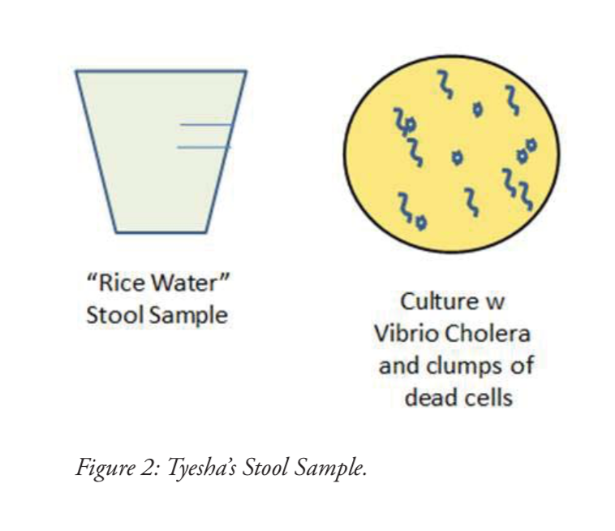

Slide 32
Questions
1. Tyesha’s stool sample was a thin, watery fluid of a chalky grey to white color. The doctor, upon microscopic examination of the stool sample, saw pieces of damaged cell and cellular debris, and V. cholera organisms. What do you think the doctor did to manage Tyesha’s illness?
2. The cholera bacteria is usually introduced as a food contaminant. Inside the GI tract, the bacteria secretes a powerful toxin, a molecule that attaches to the walls of the cells that line the intestine and eventually enters the cell, subverting the normal transport of chloride ions and the water that follows these ions. This reverses one of the jobs of the small intestine. What happens to water in the small intestine, normally? What do you think happens during a bout of cholera?
Al-Farabi Kazakh National University
Higher School of Medicine

Slide 33
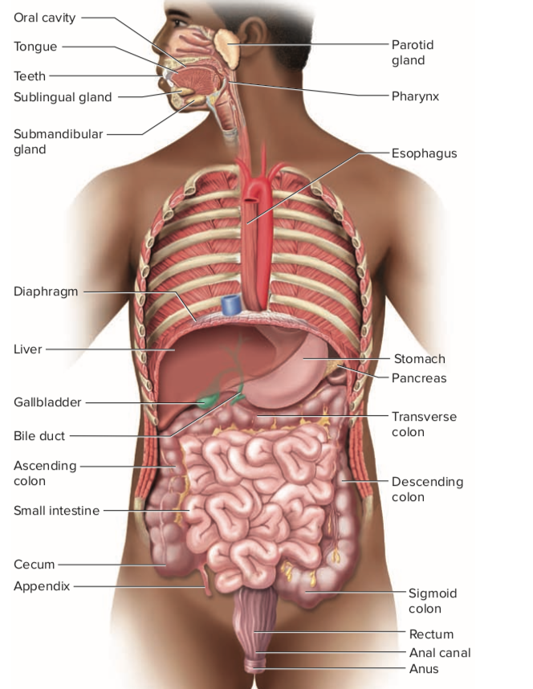
gross anatomy of the digestive tract
Mouth Through Esophagus
Stomach
Liver, Gallbladder and Pancreas
Small Intestine
Large Intestine
Figure from: Saladin, Anatomy & Physiology, McGraw Hill, 2018

Slide 34
The Mouth
the mouth - oral, or buccal cavity, enclosed by cheeks, lips, palate, and tongue
oral fissure – anterior opening between lips
fauces – posterior opening to the throat
functions:
ingestion (food intake)
other sensory responses to food – chewing and chemical digestion
swallowing, speech, and respiration

Slide 35
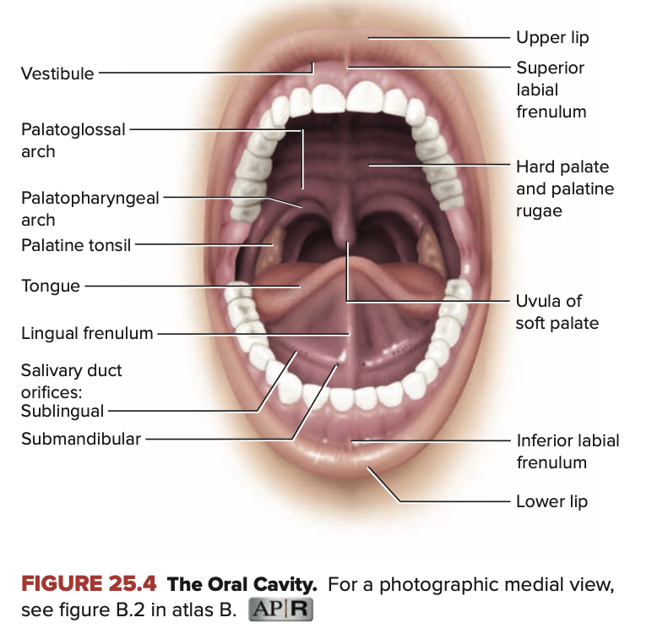
Copyright © The McGraw-Hill Companies, Inc. Permission required for reproduction or display.
Figure from: Saladin, Anatomy & Physiology, McGraw Hill, 2018

Slide 36
The Cheeks and Lips
What is the function of the Cheeks and Lips
Al-Farabi Kazakh National University
Higher School of Medicine

Slide 37
The Tongue
muscular, bulky, but remarkably agile and sensitive organ
Main structures
nonkeratinized stratified squamous epithelium
lingual papillae
body
root\vallate papillae
terminal sulcus
lingual frenulum
intrinsic muscles
extrinsic muscles
lingual glands
lingual tonsils
What is the characteristic and function of the structures?
Al-Farabi Kazakh National University
Higher School of Medicine

Slide 38
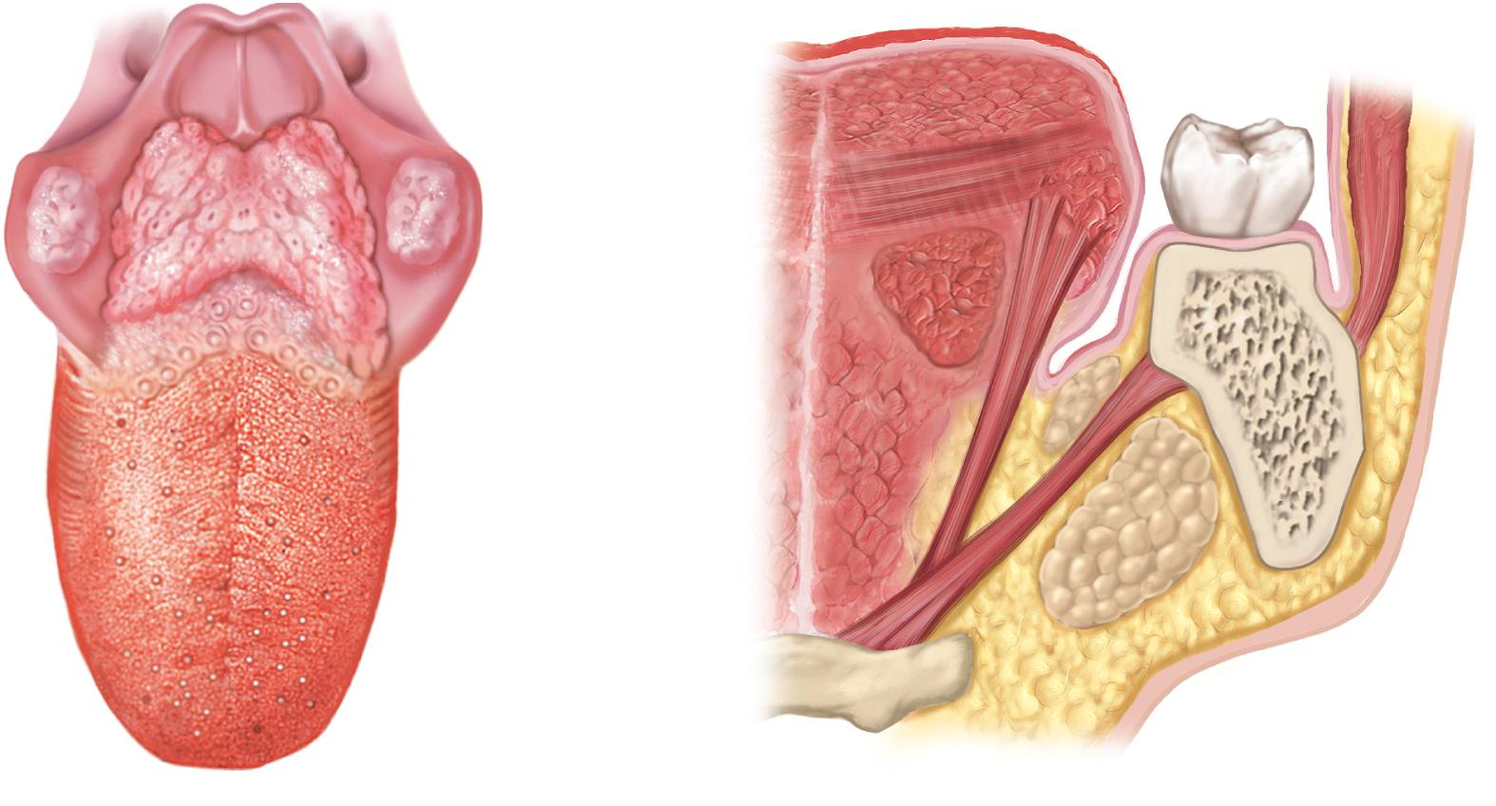
Tongue
Copyright © The McGraw-Hill Companies, Inc. Permission required for reproduction or display.
Figure from: Saladin, Anatomy & Physiology, McGraw Hill, 2018
Epiglottis
Intrinsic muscles of
Lingual
tonsils
the tongue
Root
Buccinator m.
Palatine
tonsil
1st molar
Styloglossus m.
Terminal
sulcus
Vallate
papillae
Hyoglossus m.
Genioglossus m.
Foliate
papillae
Mandible
Sublingual gland
Body
Fungiform
papillae
Submandibular gland
Mylohyoid m.
Hyoid bone
(a) Superior view
(b) Frontal section, anterior view
Figure 25.5 a-b

Slide 39
The Palate
Main structures
hard (bony) palate – anterior portion that is supported by the palatine processes of the maxillae and the palatine bones
palatine rugae
soft palate – posterior with a more spongy texture
uvula
pair of muscular arches
palatoglossal arch
palatopharyngeal arch
palatine tonsils
What is the characteristic and function of the structures?
Al-Farabi Kazakh National University
Higher School of Medicine

Slide 40
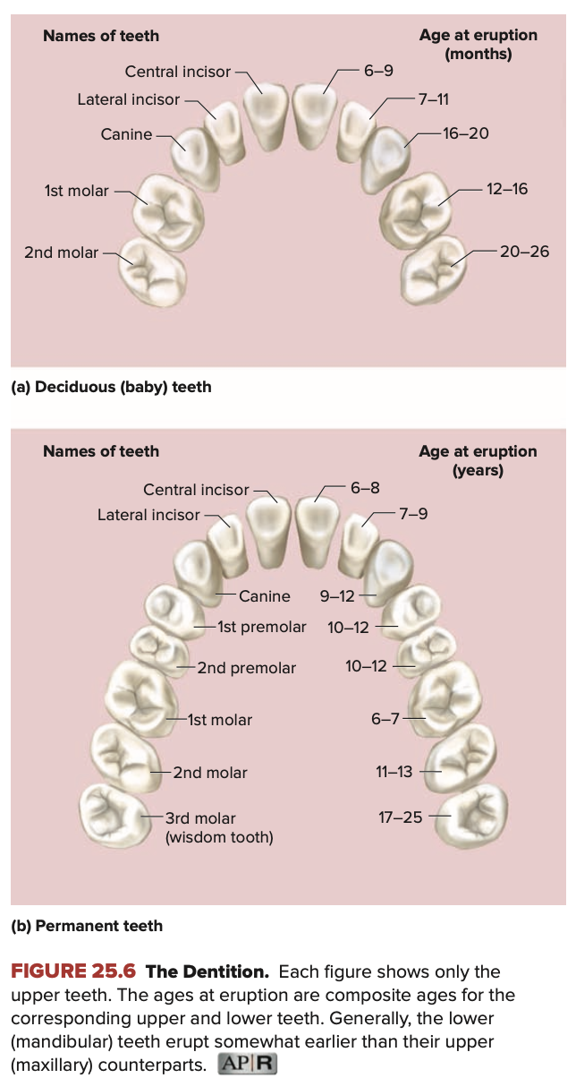
The Teeth-dentition
32 adult teeth
16 in mandible
16 in maxilla
20 deciduous (baby) teeth
from midline to the rear of each jaw
2 incisors ,1 canine ,2 premolars,3 molars
Main structures
alveolus – tooth socket in bone
gomphosis joint
periodontal ligament
gingiva (gum)
Figure from: Saladin, Anatomy & Physiology, McGraw Hill, 2018
Al-Farabi Kazakh National University
Higher School of Medicine

Slide 41
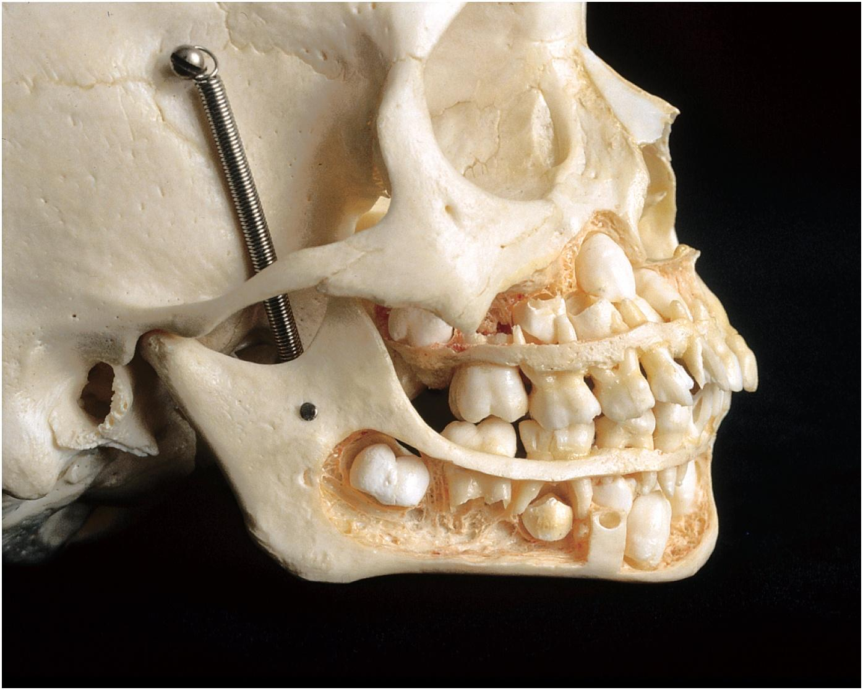
Permanent and Deciduous Teeth
Copyright © The McGraw-Hill Companies, Inc. Permission required for reproduction or display.
*
*
*
*
© The McGraw-Hill Companies, Inc./Rebecca Gray, photographer/Don Kincaid, dissections
Figure from: Saladin, Anatomy & Physiology, McGraw Hill, 2018

Slide 42
Mastication
breaks food into smaller pieces to be swallowed and exposes more surface to the action of digestive enzymes
How mastication happen?
Al-Farabi Kazakh National University
Higher School of Medicine

Slide 43
Salivary Glands
intrinsic salivary glands – small glands dispersed amid other oral tissues
lingual glands ,labial glands and buccal glands
extrinsic salivary glands – three pair connected to oral cavity by ducts
parotid
submandibular gland
sublingual glands
Salivation-extrinsic salivary glands secrete about of 1 to 1.5 L of saliva per day
What is the functions of saliva; its composition and pH?
How the nervous system regulates salivation ?
Al-Farabi Kazakh National University
Higher School of Medicine

Slide 44
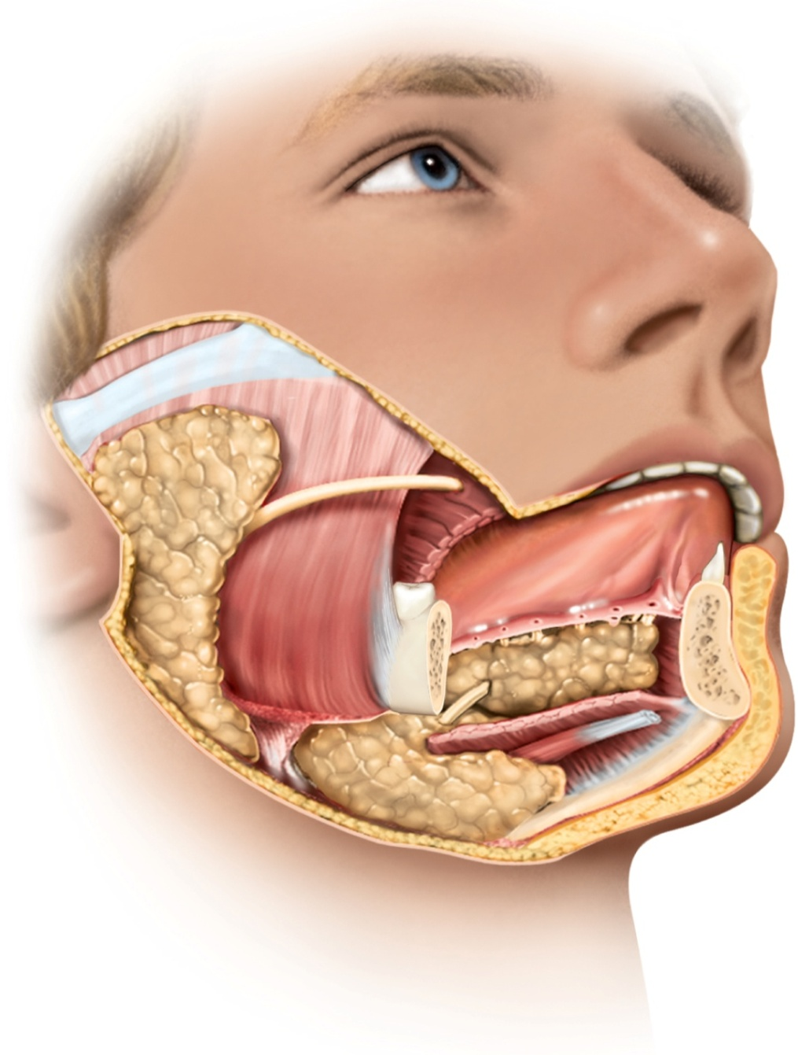
Where are the glands located and what is the structural characteristics?
Copyright © The McGraw-Hill Companies, Inc. Permission required for reproduction or display.
Figure from: Saladin, Anatomy & Physiology, McGraw Hill, 2018
Parotid
gland
Parotid duct
Tongue
Sublingual
ducts
Figure 25.9
Masseter
muscle
Submandibular
duct
Submandibular
gland
Lingual
frenulum
Sublingual
gland
Mandible
Opening of
submandibular
duct

Slide 45
Pharynx and Esophagus
Pharynx - muscular funnel that connects oral cavity to esophagus and allows entrance of air from nasal cavity to larynx
- pharyngeal constrictors
esophagus – a straight muscular tube extends from pharynx to cardiac orifice of stomach passing through esophageal hiatus in diaphragm
lower esophageal sphincter
nonkeratinized stratified squamous epithelium
esophageal glands
Describe the function of these muscles?

Slide 46
Swallowing (Deglutition)
a complex action involving over 22 muscles in the mouth, pharynx, and esophagus
swallowing center – pair of nuclei in medulla oblongata that coordinates swallowing
communicates with muscles of the pharynx and esophagus by way of trigeminal, facial, glossopharyngeal, and hypoglossal nerves.
swallowing occurs in two phases:
buccal phase – under voluntary control
pharyngoesophageal phase – is involuntary
what occurs in each phases of swallowing?
Al-Farabi Kazakh National University
Higher School of Medicine

Slide 47
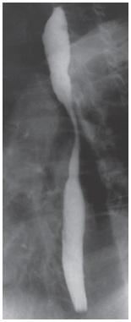
X-ray: Swallowing in Esophagus
What actions prevent the pharynx from forcing food back into the mouth or nose?
Copyright © The McGraw-Hill Companies, Inc. Permission required for reproduction or display.
Figure from: Saladin, Anatomy & Physiology, McGraw Hill, 2018
Upper
esophagus
Peristaltic
contraction
Figure 25.11b
Bolus of ingested
matter passing
down esophagus
(b)
© The McGraw-Hill Companies, Inc.,/Jim Shaffer, photographer

Slide 48
Reference:
Saladin, Anatomy & Physiology, McGraw Hill, New York,2018

